Slide 1
Universidad Nacional de Educación a Distancia Prof. Frederic Chaume Universitat Jaume I
Translating and dialogue writing for dubbing
Basic skills for a fast‐growing market

Slide 2
TYPES OF AUDIOVISUAL TRANSLATION
Subtitling
Revoicing
Spoken output (SL) > Written output (TL)
AVT
Spoken output (SL) > Spoken output (TL)
Notes:
Language transfer of AV texts: there are two main approaches

Slide 3
Types of AVT: Revoicing
The original soundtrack is totally replaced by a new one in the TL and the target viewer can no longer hear the original exchanges
Revoicing
- Lip synch dubbing
The translation is overlapped and the original spoken dialogue is still audible in the background
- Voice-over
Interpreting
Free commentary
(es, de, en)
Díaz Cintas and Orero (2010: 41)

Slide 4
1. AUDIOVISUAL TRANSLATION TYPES: REVOICING AND CAPTIONING
dubbing
voice-over (including Polish narration and Russian dubbing/partial dubbing /Goblin Translation –domesticating voice-over)
simultaneous interpreting (film festivals, vee-jays)
free-commentary
audio description for the blind and visually-impaired (AD)
audiosubtitling
______________________________________________
subtitling (+ surtitling + live subtitling)
subtitling for the deaf and the hard-of-hearing (SDH)
________________________________________
New genres, formats and AVT Types
videogames (dubbing + subtitling + localization)
fansubs, fandubs, webtoons
advertising, infomercials (dubbing, 2, subtitling, voice-over, new ads)
instructional videos, webinars, corporate videos (voice-over)

Slide 5
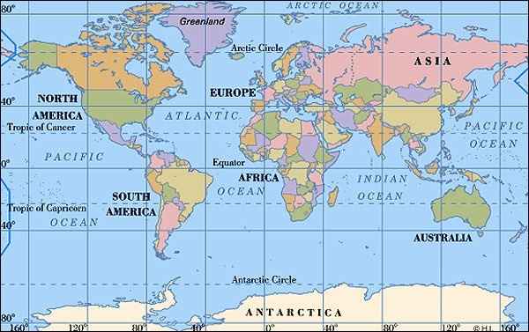
The dubbing landscape
Where is dubbing predominant?

Slide 6
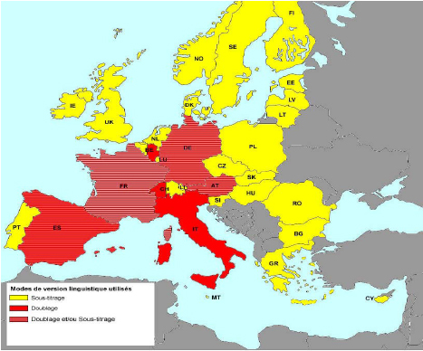
AVT modes on cinema screens in Europe
http://mediadeskpoland.eu/upload/PP_Comite_media_280708_FINAL.pdf

Slide 7
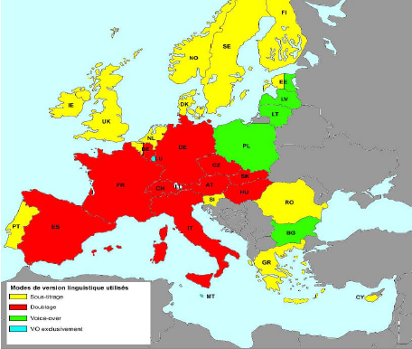
AVT modes on TV in Europe
http://mediadeskpoland.eu/upload/PP_Comite_media_280708_FINAL.pdf

Slide 8
Europe
Changing landscape
Greece: TV series and soap operas are dubbed
Norway and Denmark: some teen pics are being dubbed
Russia: incorporating dubbing
Poland: incorporating subtitling in cinemas
Dubbing countries: MTV is introducing voice-over into fiction programmes
Notes:
No es una cuestión blanca o negra. Todos subtitulan un poco, y los de voice-over diblan y subttiulan también. En Asia los programas están doblados y subtitulados a la vez en muchos países y regiones, en la misma o diferente lengua. Dependiendo del dispositivo también varía la modalidad. Los USA sólo doblan para exportar (doblan a otras lenguas).

Slide 9
THE MARKET - Dubbing companies work for:
TV stations
Cable and digital broadcasting channels
DVD, Blue-Ray
Cinema
Film festivals
Film clubs
How many products are dubbed?
In house vs. foreign production
Exercise 1:
Carry out an Internet search. Find at least 3 dubbing/recording studios in your country.
Check if the studios you found are included in the list of dubbing and subtitling companies provided at www.trama.uji.es
Source: Chaume (2012)

Slide 10
Openings and Job Opportunities
civil servants in public TV stations
in-house translators (employees) in dub/sub companies
and freelance translators
access to the market:
find dub/sub companies addresses (TV, DVD, etc.)
set up a personal interview + submit CV there
make a translation exam/proof
you’re service providers: offer direct and reverse translation, with or without script

Slide 11
Professional issues
Academic and professional associations that run projects/organize activities that are relevant to AVT:
AIDAC – Associazione Italiana Dialoghisti Adattatori Cinetelevisivi (Italy)
ATAA – Association des Traducteurs/Adaptateurs de l'Audiovisuel (France)
ATAA's Facebook Page
ATRAE – Asociación de Traducción y Adaptación Audiovisual de España
AVTE – Audiovisual Translators Europe
BZO –Beroepsvereniging van Zelfstandige Ondertitelaars (Netherlands)
DHAP – Društvo Hrvatskih Audiovizualnih Prevoditelja (Croatia)
ESIST – European Association for Studies of Screen Translation
ESIST's Facebook page
European Society for Translation Studies
FIT (Fédération Internationale des Traducteurs – Audiovisual Translation Committee
FBO – Forum for Billedmedieoversættere (Denmark)
IATIS – International Association for Translation and Intercultural Studies
NAViO – Norsk Audiovisuell Oversetterforenings (Norway)
STAW – Stowarzyszenie Tłumaczy Audiowizualnych (Poland)
STAW's Facebook Page
SUBTLE – Subtitlers for Excellence (UK)
Suomen Av-kääntäjien Sivustolle (Finland)

Slide 12
RATES IN SPAIN
Translation // Dialog Writing
Films/TV series 36,50 € /reel (10’) 40,00 € /reel (10’)
Cartoons 34,75 € /reel (10’) 37,00 € /reel (10’)
Documentaries 42,00 € /reel (10’) 15,75 € /reel (10’)
Without Script and ReverseTranslation: + 100%
Dubbing actors (voice talents) 25-30€ /conv. + 3€/take
France: price per dialogue line (TV) / per 20’ reel (cinema)

Slide 13
The dubbing process
Producer
(International Agents→) Distributor
TV Channel / Exhibitor
Dubbing Studio (Casting and Production)
TV Channel / Cinema House
Source: Chaume (2004)

Slide 14
The dubbing process from the translator’s point of view
Dubbing Studio (Casting and Production)
Translator (Rough translation)
Dubbing Studio (Dubbing actors, director, etc. )
Dialogue Writer/ Adapter (Synchronised translation)
Adapters are responsible for synchronising the translation with the audio and visual cues of the original.
Should translators be responsible for dialogue writing?
Source: Chaume (2012)

Slide 15
The translator’s task
Receives: script + FTP (DVD)
Uses: Computer, access to the Internet, general & specialised dictionaries, various translation resources
Submits: Word file with the translation sent by e-mail (+script, + DVD, + a printed version of the translation). Translation + Dialogue writing
Occasionally: specific software to separate takes or to count actors and takes
Source: Chaume (2012)

Slide 16
SCRIPTS AND DIALOGUE LISTS Documentaries (complete script)
BEYOND 2000 ‑ SERIES 6/90 ‑ PROGRAM 012 ‑ INTERNATIONAL NO. 182 1
SHOT
NO. VISION (LENGTH OF SHOT) SOUND OPENING TIMING
1. BILLBOARD MUSIC (1) BEGINS 1.30.00
NICOTINE PATCH.
(18.20) IAIN FINLAY (V/O) 1.34.00
Is there an easy way to give up
smoking?
AT 1.38.00:
Can the one in ten of us who will
die from smoking related diseases
be saved?
WIPE
2. BILLBOARD 1.48.20
SNAKE TRACKER. IAIN (V/O) 1.49.20
(6.05) What did I do to deserve this
story. Couldn't someone else have
done it?
WIPE 1.55.00
3. BILLBOARD Ad who will win the race to mass
DIAMOND FILM. produce diamonds? Find out on
(8.20) Beyond 2000.
4. OPENING SEQUENCE. MUSIC CHANGE (2) 2.03.20
(16.07) Theme 2.06.00
5. TITLE ‑ BEYOND 2000 2.20.02
(1.23)
DISSOLVE
6. EL IAIN WALKS ACROSS 2.22.00
STUDIO.
(3.00)

Slide 17
THE TARGET TEXT
1. 03.52
NARRATOR From Tarifa, in the South of the Iberian Peninsula, to Cabo Creus, up in the North, the Mediterranean Sea is a symbol of our identity and a source of richness. But above all, the Mediterranean Sea has a deep sentimental feeling for those who live next to it.
________________________________________________________
2. 04.13
NARRATOR Along the Mediterranean shores we can find the roots of several civilizations that have settled in these lands. We have been enjoying one of the most wonderful climates of the planet since our ancestors settled here.
__________________________________________________________

Slide 18
DIALOGUE WRITING: LAYOUT (I) GENERAL TRENDS
Respect to the audiovisual narrative conventions as far as possible
Scene changes (not shot changes)
Action breaks
Turning points
One character leaves or comes into scene
Audiovisual Punctuation Marks:
Flash backs, flash forwards
Iris, wipes, etc.

Slide 19
The target text layout (France)
Street Soccer Episode 19-Trop d’amour tue l’amour / “Hot Stuff” ---- Téleimages Kids
___________________________________________________
Boucle : 1 de 10:00:00:00 à 10:00:58:22 Durée: 00:00:58:22
___________________________________________________
Akim : (reac)
Mr. Salim : Now watch...
: Watch carefully...
Albert the b : Oooooh!
: Never seen anything like it!
Ali : (reac)
Mr. Salim : And that’s nothing! Wait till you see what’s next!
: Watch...
: what he’s going to do!
: And now he’s going to make a super fast pass!
Ali : (reac)
The Scorpion : (“Yeah! Yeah! We’re awesome!”)
Mr. Salim : See, I told you!
Albert the b : hhh!
: I think the blues don’t have a chance...
: against...
Mr. Salim : (mm__
Albert the b : against that!
Mr. Salim : __end)
Albert the b : So they are prepared!
__________________________________________________
Boucle : 2 de 10:00:59:10 à 10:00:59:23 Durée: 00:00:00:13

Slide 20
The target text layout (Germany)
ER --- Emergency Room. Episode 247
________________________________________________________________
023
KOVAC: (OFF/ON) Sam!
SAM: (OFF/ON) Wir fahren noch mal zu Shelley’s, (.) zur Union Station (.), zum Park...
KOVAC: (über.) Sam! (..) Sam, der Wagen steht...
___________________________________________________________________
028
SAM: (Laute)
KOVAC: (OFF/ON) Er weiss mit seiner Krankheit umzugehen und, dass er viel trinken muss.
___________________________________________________________________
036
MORRIS: (Laut) Die Tagenschicht (..) (Kuss) (Laut) Ist das Leben nicht herrlich?
JANE: (Laute)
___________________________________________________________________

Slide 21
The target text layout (Italy)
Cuore d’Africa 5 – Ep. 4
____________________________________________________________________________
00:35 106
ALICE FC) Conterò fino a tre. / (IC) Danny! / (DS) Sei pronto?
DANNY (da CL) Scusa… sì, pronto.
ALICE Okay? / (da FC) Uno / due / tre!
CHARLOTTE (da FC) Corri, Ngozi, corri! (FIN. FC)
DANNY (01:09) (FC) Fila dentro. / (IC) (fiato)
____________________________________________________________________________
01:13 107
ALICE (da FC) Allora (fiato)… che ne pensi?
DANNY (da FC) Comincia a funzionare…
CHARLOTTE Possiamo liberarlo adesso?
ALICE No, se non torna il proprietario.
CHARLOTTE E allora che facciamo?
ALICE Aah, potresti andare dai fornitori con Danny, va bene? (FIN. FC)
DANNY No lei non può. / (FC) Ci vado con Dup.
ALICE (su muto) Ma, c’è spazio per tutti e tre no?
DANNY (fiato) Forse un’altra volta. / (FC) Sai una cosa? / (IC) Ti porto
all’asta degli animali la prossima settimana. (FIN. FC)
ALICE (FC) (verso)
CHARLOTTE (verso)
___________________________________________________________________________
01:43 108

Slide 22
United States of America
Loop # | TCR | Character | ENGLISH | GERMAN
1 | 1:00:50 | EARL | Oh God. God grant me the serenity to accept the things I cannot change | Gott, gib mir die Gelanssenheit, Dinge hinzunehmen, die ich nicht ändern kann.
2 | 1:00:55 | MARSHALL | Why do you fight it so hard, Earl? | Warum kämpfst so hart dagegen an, Earl?
3 | 1:00:58 | EARL | Courage to change the things I can | Den Mut, Dinge zu ändern, di ich ändern kann.
4 | 1:01:01 | MARSHALL | Come on. You’ve been a good boy for a long time You know you wanna do this | Komm schon. Du warst lange Zeit ein gutter Junge. Du weisst, dass du das machen willst.

Slide 23
DIALOGUE WRITING: SYMBOLS (II) GENERAL TRENDS
(OFF) → Off screen dialogues
(ON) → On screen dialogues (by default)
(G) → Paralinguistic signs
/ SIMPLE PAUSE
// DOUBLE PAUSE

Slide 24
DIALOGUE WRITING: LAYOUT (II) B) SYMBOLS (Spain)
→Depend on conventions in each company
(OFF) Voice Off, Out of Camera
(ON) On Screen, Field
(DE) The character shows his/her back to the camera
(DL) The character is far from the camera
(SB) The character is on screen, but we can’t see his/her mouth
(G) Paralinguistic gestures
(A la vez) Two or more characters speak at a time
(P) (T) (X) A character interrupts another character
(AMBIENTE) General shot pans - No dialogues in the script but a translation is offered
(R) Laughter
(LL) (PL) The character cries or weeps
/ Short Pause (2”-5”)
// Long Pause (6”-14”)

Slide 25
DIALOGUE WRITING C) SYNCHRONIZATION OR LIP-SYNC
Three types of synchronization:
phonetic or lip synchrony: only close-ups, big/extreme close-ups and detailed shots (lips)
(p,b,m,f,v + open vowels: a, e, o)
kinetic synchrony or body movement synchrony: translation has to be coherent with movements
isochrony or synchrony between utterances and pauses (German: texten; French: adapter)
→ clips

Slide 26
DIALOGUE WRITING D) ORAL SPEECH: dubbese
The creation of a convincing script, ideally meeting all the demands of the different types of synchrony, yet still creating the illusion of original dialog.
Unlabored dialogs, avoiding artificiality
But never real oral speech, it must comply with the standard norms (phonetics, morphology, syntax):
written spoken
–____________________________X__________+
Translation routines: Pavesi, Baños, Marzà, Chaume, Prats, Romero, Bruti, Freddi, Matamala, Izard, Santamaria, Kozloff, Quaglio, Valdeón, Valentini...

